Slide 1
CHAT SUMMARIZATION USING NLP
Presented by:
V. Tejasri– 2211cs020525
V. Tejaswini – 2211cs020526
V. Sravya – 2211cs020528
V. Sai charan– 2211cs020530

Slide 2
Contents
Objectives & Use Case
Methodology
Dataset Details
Data Preprocessing
Model Implementation
Architecture diagram
Deployment Details
Frontend Screenshots
Conclusion
Future Scope

Slide 3
1.Objectives
This project develops an AI-powered Chat Summarizer that converts lengthy conversations into concise summaries using Google's Gemini Model. It automatically extracts key points, decisions, and action items from chat transcripts, saving review time. This application comes as a solution that works across platforms like WhatsApp, Slack and Teams without requiring local model training. Designed for both professional and personal use, it delivers instant, accurate summaries to boost productivity.
Use Case
1. Customer Support Ticket Resolution.
2. Meeting Minutes Automation.
3. Community Moderation Aid.
4. Personal Chat Digest

Slide 4
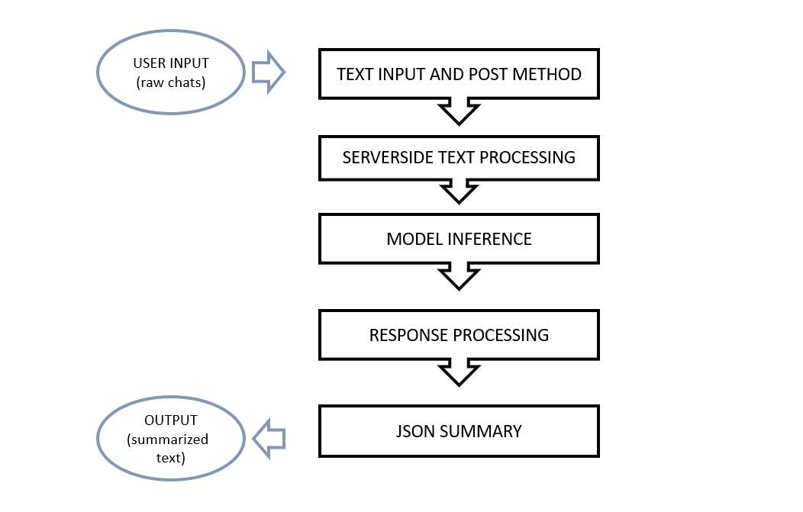
2.Methodology
Browser → Flask backend (as JSON)
Ensures clean input for model processing
Tokenization, speaker tracking,
context analysis
Handles API errors
JSON exchanges allow horizontal scaling.
Fig 1 : Methodology

Slide 5
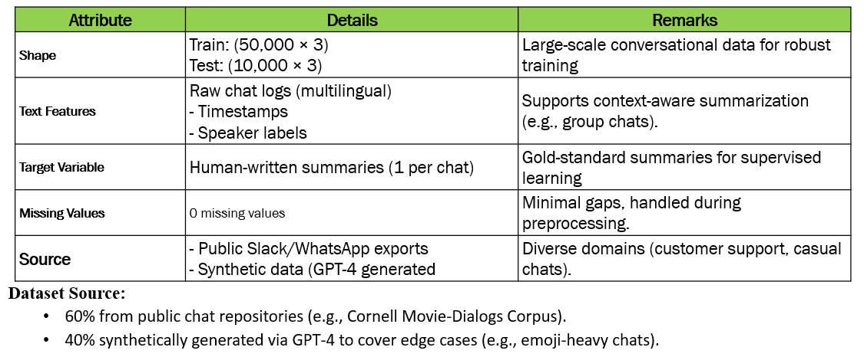
3.Dataset Details
Table 1 : Meta Data

Slide 6
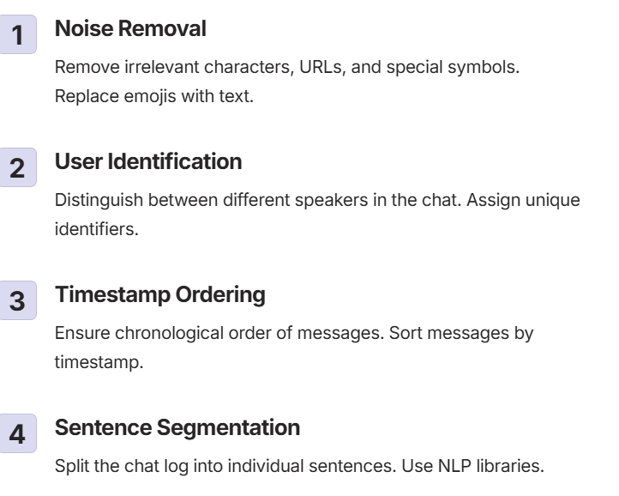
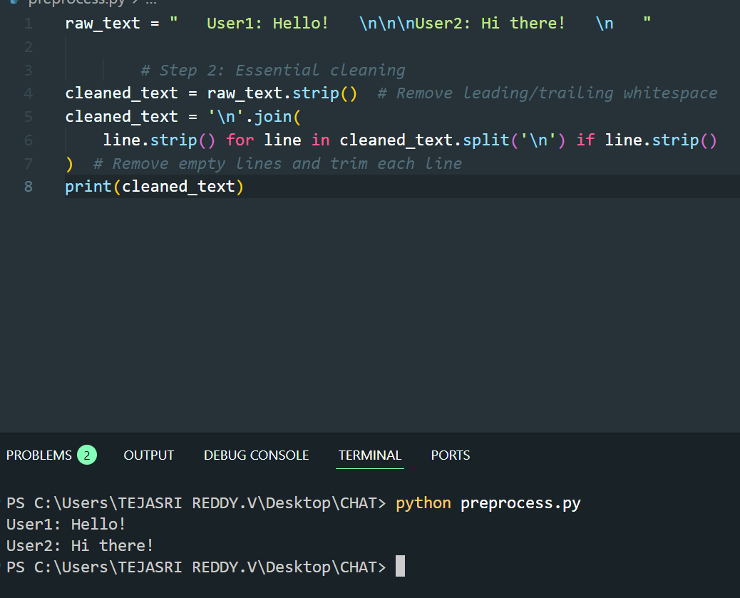
4.Data Preprocessing
Fig 2 : preprocessing

Slide 7
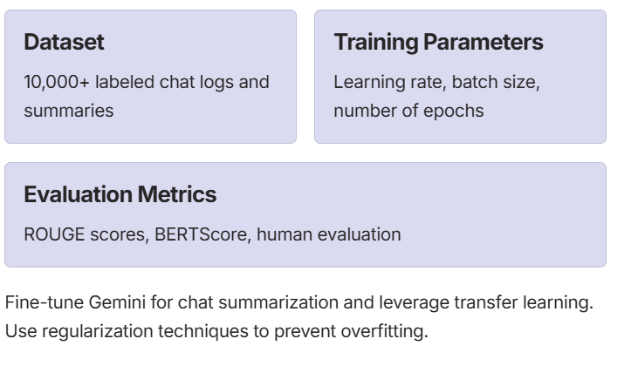
5.Model Implementation
Our Chat Summarizer uses TRANSFORMERS(BERT) to generate abstractive summaries without local model training. The Flask backend sends sanitized chat text to Gemini with a structured prompt, specifying output length and key elements (decisions/actions).

Slide 8
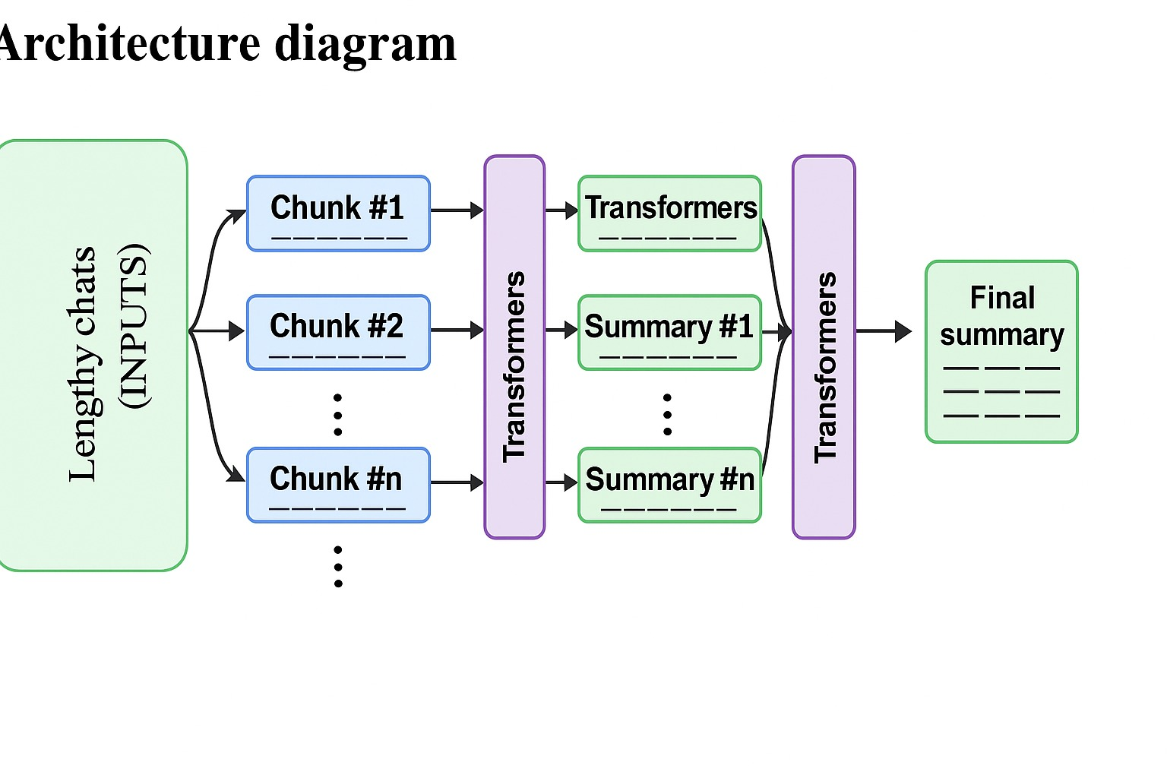
6.Architecture diagram
Lengthy Chats
(INPUTS)
Fig 3 : Architecture

Slide 9
7.Deployment Details
Github
Repository linkhttps://github.com/tejasrireddy44/CHAT_SUMMARY_NLP
Files created and uploaded into github:
app.py
Home.html
index.html
preprocessing.py
Mk.py

Slide 10
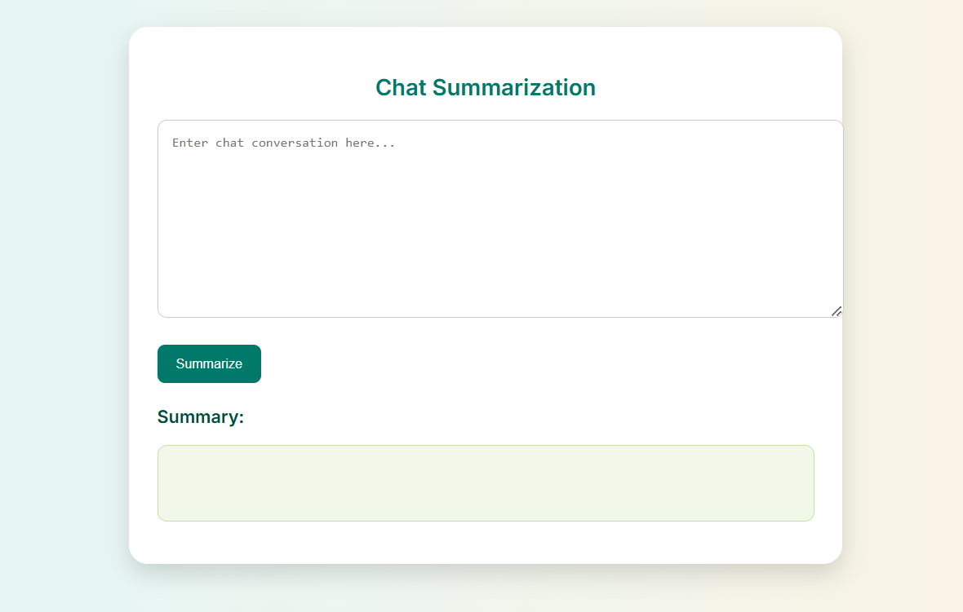
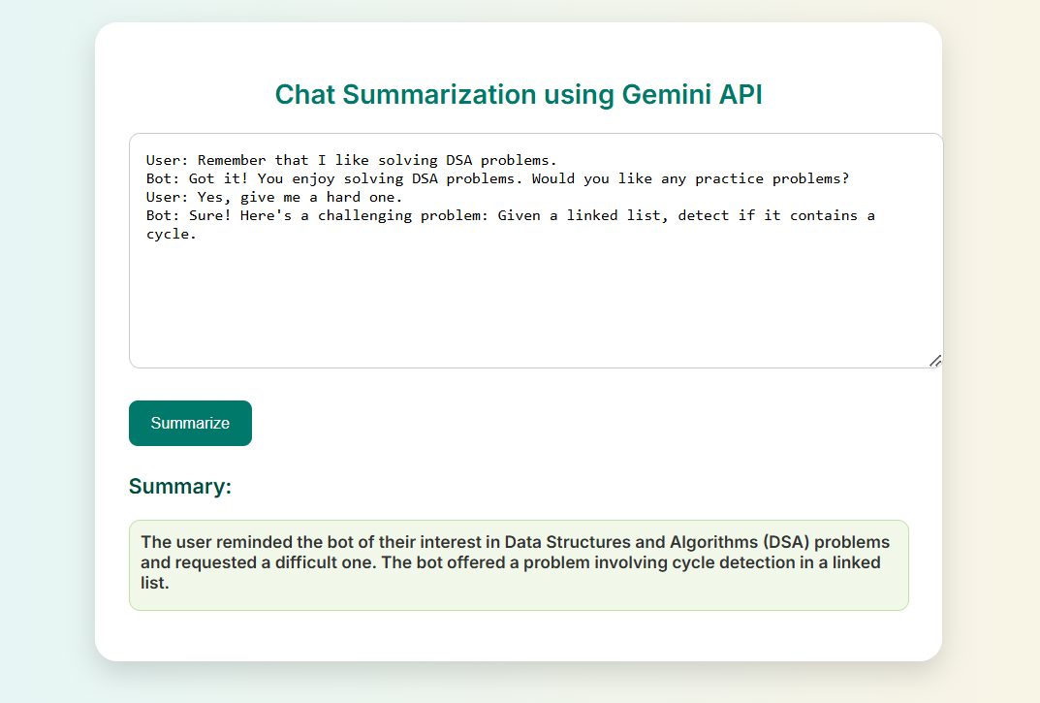
8.Front End Screenshots
Fig 4: RESULTS

Slide 11
9.Conclusion
The Chat Summarizer app successfully leverages Transformers(BERT large cnn)to transform lengthy conversations into concise, actionable summaries with minimal preprocessing. By integrating advanced NLP capabilities without requiring local model training, the app delivers fast, accurate, and scalable summarization for diverse use cases—from customer support to meeting notes. Its user-friendly interface and real-time processing enhance productivity while maintaining privacy through secure API calls. Future enhancements could include multi-language support and customizable summary templates, further solidifying its value as an essential communication tool.

Slide 12
10. Future Scope:
Advanced Personalization
Implement user-specific summary customization based on preferences.
Multi-Modal Summarization
Incorporate speech-to-text for summarizing voice messages.
Real-Time Summarization
Summarize messages on-the-fly in group chats and live conversations.
Provide TL;DR (Too Long; Didn’t Read) for long discussions.
Sentiment Analysis Integration
Integrate image-to-text (OCR) for summarizing text from images.
Analyze the emotion & tone of conversations.
Categorize summaries as positive, neutral, or negative.

